Slide 1
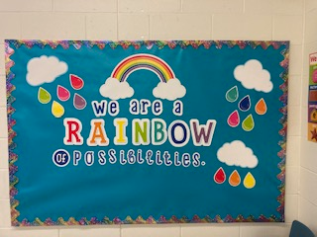
Welcome to Prekindergarten!
Teacher: Janie Register
Fort Braden School
Room 403

Slide 2
Important Information
School Day
8:30 a.m. to 2:50 p.m.
School Supervision
7:45 a.m. to 3:00 p.m.
Please note for the health and safety of our students, parents dropping off or picking up their children should do so in the car loop. If you must pick your child up before dismissal, please park in the loop and call the front office: 850-488-9374.
If you need to schedule a conference with myself, administration or guidance, please call to set up a time to meet via Teams or phone.
For up to date information regarding Fort Braden School please visit our website:
https://www.leonschools.net/ftbraden
For information regarding bus transportation, please call Leon County Schools Transportation: 850-487-1464

Slide 3

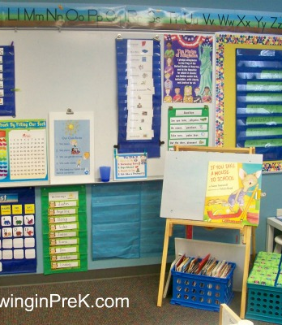
A Little About Our Program
We have two PreK classes here at the Fort. Both classes provide children with a safe, secure, and nurturing learning environment. Learning experiences are planned daily to provide children with instruction in the following developmental areas:
cognitive
independent functioning
social/emotional and
communication.
This Photo by Unknown author is licensed under CC BY-NC-ND.

Slide 4
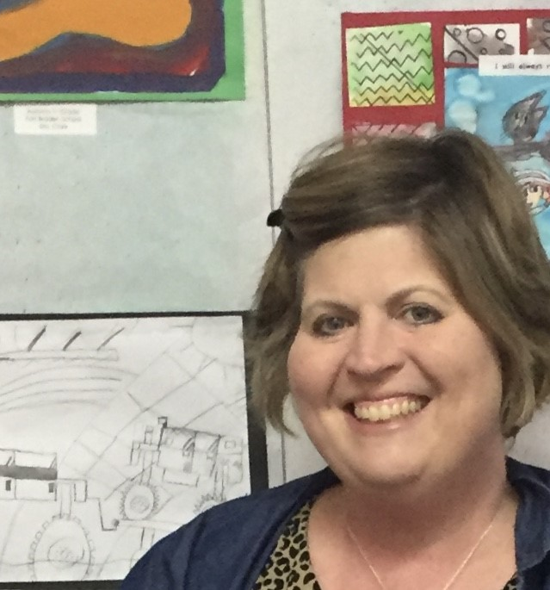
Meet Your Teacher
Hi Friends! My name is Janie Register. I am married to Josh and we have two daughters, Jadie and Jessie. I love all things Disney, traveling and shopping! This is my 22nd year in education. I am so excited to be your teacher this school year and have many wonderful things planned for you to learn and do!

Slide 5

Our Day Together Daily Health Check Sign In, Fine Motor and Brain Bin Activities Morning Meeting Breakfast Developmental Play Small Groups (early literacy and math) Music and Movement Lunch Rest Snack Brain Bins Dismissal *While you are welcome to send your child with breakfast and lunch, both are provided free of charge to all students at Fort Braden School. Please note that breakfast is typically served around 8:45am.
This Photo by Unknown author is licensed under CC BY-NC-ND.

Slide 6
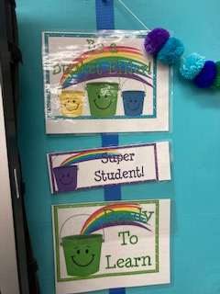
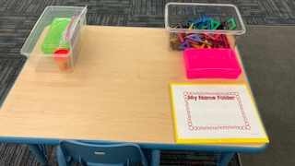
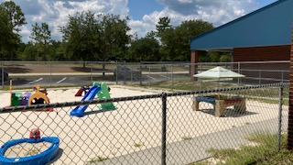
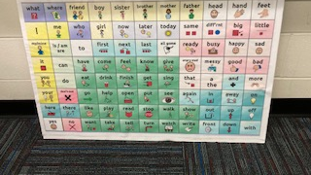
Sneak Peek of Your Classroom and Playground

Slide 7

Classroom Communication
In lieu of sending home a daily folder, our mode of communication will be through Remind. More information to following regarding this application. In addition, I may be reached via email at registerj@leonschools.net. You may also call and leave a message for me at school: (850) 488-9374. Please note: For an immediate response, Remind is the best mode of communication.
Parent Conferences All conferences will be held via teams or phone.

Slide 8


Classroom Expectations
Listen and follow directions.
Use kind words.
Keep hands and feet to yourself.
Walk in the classroom.
Wear your mask inside and outside the classroom.

Slide 9
Positive Behavior Support Plan
We use a color system in our classroom. Children are reminded each day about making choices. They begin each day on Green: Ready to Learn. If children make positive choices they may advance to purple. If they make negative choices, they move their clip down to yellow and then to red. Should a child have to move their clip to red, I will call home to let you know about the choices they made that day.

Slide 10
PreK Supply List
Each child will need the following:
Water bottle sent daily
Face mask sent daily
Snack sent daily
Nap mat
Towel for rest time
Change of clothes
Please label all supplies with your child's name.
----------------------------------------------------------
PreK Wishlist:
Hand soap
Baby wipes

Slide 11
Resources for At-Home Learning
Canvas: https://www.leonschools.net/Page/49521
Starfall: https://pbskids.org/
PBS Kids: https://pbskids.org/
Leon County Schools Early Childhood Programs: https://www.leonschools.net/earlychildhood
Florida Office of Early Learning: http://www.floridaearlylearning.com/parents

Slide 12
Title I at Fort Braden School
Leon County Title I Program receives Federal funds to provide supplemental instruction to students of public schools, neglected or delinquent sites, non-public schools, and homeless children. Services are provided for all students school-wide at Fort Braden. All K-8 Title I schools have 60% or more of their students on free or reduced lunch as determined by an Annual Economic Survey. Services are also provided to all students at eligible, neglected, or delinquent sites including Capital City Youth Services, Father Flanagan's Boys and Girl's Town of North Florida, Florida Baptist Children's Home, Homeless, Disc Village/ADT, Leon County Detention Center, Leon County Jail, PACE Center for Girls, Devereux Residential Center, Tallahassee Marine Institute, and LCS Ghazvini Transition Center.
Leon County Title I school plans are written by individual school sites and are directly correlated to the School Improvement Plan.
Schools in Leon County use Title I funds to support federal, state and local goals reflected in individual school plans. Teachers, parents, administrators, students, and all stakeholders are involved in the development and implementation of each school's plan. A strong parental involvement component is integrated throughout the plan at each site and each school utilizes a Parent, Student and Teacher Compact.

